Slide 1
Customer Segmentation and Prediction using RFM Analysis and Machine Learning

Slide 2
Problem Statement
The retail industry faces challenges in understanding and segmenting customers based on their purchase behavior.
Traditional methods often lack precision and fail to provide actionable insights for targeted marketing strategies.

Slide 3
Objectives of the Project
The project addresses the need for businesses to understand customer behavior more deeply to tailor marketing strategies effectively.
By analyzing RFM scores and using machine learning models, we aim to segment customers into meaningful clusters and predict future customer behavior.
Perform RFM analysis to calculate Recency, Frequency, and Monetary scores for customers.
Segment customers into clusters based on RFM scores using K-means clustering.
Train a machine learning model (Random Forest Classifier) to predict customer clusters.
Provide an executable file for making single customer predictions based on RFM scores.

Slide 4
Datasets
Online Retail Dataset
The dataset contains information about customer transactions, including InvoiceDate, Quantity, UnitPrice, and CustomerID. It serves as the primary data source for RFM analysis.
This dataset was taken from the Machine Learning Repository of the University of California.
RFM Scores Dataset
After RFM analysis and clustering, a dataset containing RFM scores, cluster labels, and other relevant information is created. This dataset is used for model training and evaluation.

Slide 5
Methodology
Data Collection and Preprocessing
The Online Retail dataset is collected and preprocessed using Python libraries like Pandas. Feature engineering was performed in which Total Amount column was generated.
RFM Score Calculation
Recency, Frequency, and Monetary scores are calculated for each customer based on their purchase history.
RFM Score Normalization
RFM scores are normalized to ensure uniformity and comparability across different customers. Quantiles are used to divide customers into quartiles.
K-means Clustering
K-means clustering is applied to segment customers into clusters based on their RFM scores. The optimal number of clusters is determined using The Elbow Method.
Model Training and Evaluation
A Random Forest Classifier is trained using RFM scores as features and customer clusters as labels. The model is evaluated using test data to assess its accuracy and performance.
Executable File Development
An executable file is developed to accept RFM scores from users and predict the customer cluster using the trained machine learning model.

Slide 6
Results
Insights from Customer Segmentation
Customer segmentation provides valuable insights into customer behavior and preferences. It helps businesses identify high-value customers, retain loyal customers, and re-engage with at-risk customers.
Model Performance and Accuracy
The machine learning model demonstrates 96% accuracy in predicting customer clusters.
Interface Usability
Continuous evaluation and refinements are necessary to improve interface usability.

Slide 7
Conclusion
The project successfully demonstrates the application of RFM analysis and machine learning techniques in customer segmentation and prediction.
It provides actionable insights for businesses to improve customer engagement, retention, and profitability.

Slide 8
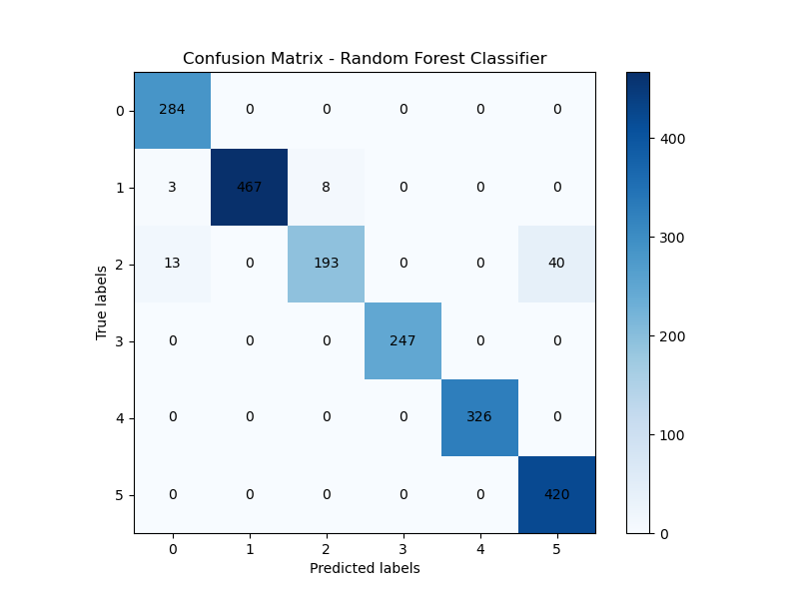
Confusion Matrix

